Slide 1
Master-Slave Node Configuration and Application Deployment
Bairagoni Bhargavi

Slide 2
Agenda
To set up a master-slave architecture.
Deploy and manage applications across multiple slave nodes.
Explore manual, automated, and scripting-based deployment methods.

Slide 3
Master Slave Configuration
The Master-Slave Configuration refers to a setup in which one system (the "master") controls or manages one or more other systems (the "slaves"). The master system is typically responsible for initiating actions, controlling processes, and coordinating tasks, while the slave systems carry out the tasks or operations as directed by the master. This configuration is commonly used in various computing environments, including Jenkins CI/CD, and server management.
The slave performs the actual work or processing based on instructions received from the master. For example, in a database replication setup, the slave might replicate the data from the master.

Slide 4
Method-1
Master and Slave Nodes Configuration:
Master: Controls and manages the slave nodes.
Slave Nodes:
- Slave-1: Nginx Installation.
- Slave-2: Httpd Installation.
- Slave-3: SonarQube Setup.
- Slave-4: Tomcat Setup.
- Slave-5: Deployment of a Static Application.

Slide 5
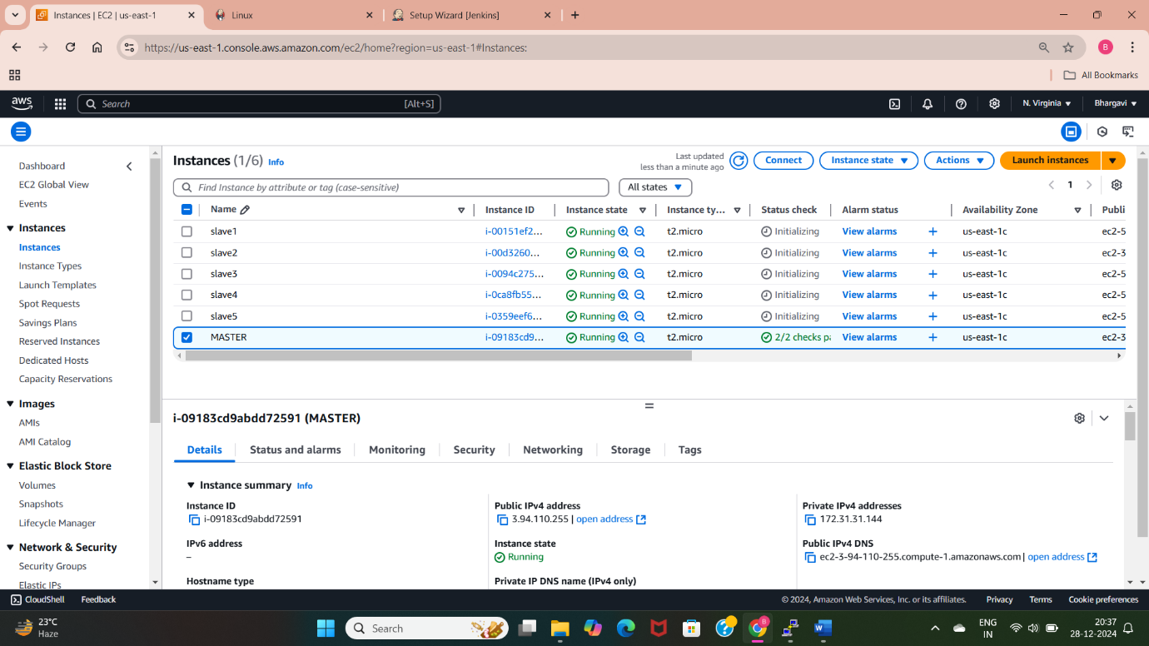
SET UP
Configure one master node to manage five slave nodes.
Install and start Jenkins in master server.
Establish SSH communication between master and slaves using public key of the master.
Install run time of Jenkins in all the servers.

Slide 6
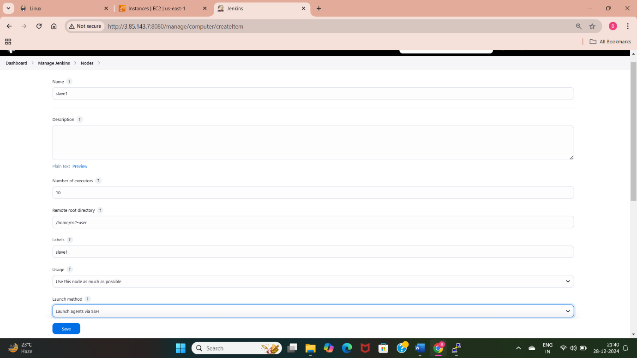
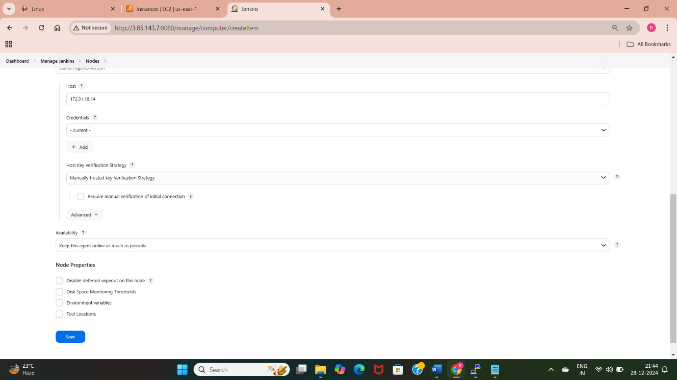
Slave-1
Install and configure Nginx.
Create a slave1 node and label.
While building the job restrict the builds using label.
In execute shell provide commands.

Slide 7
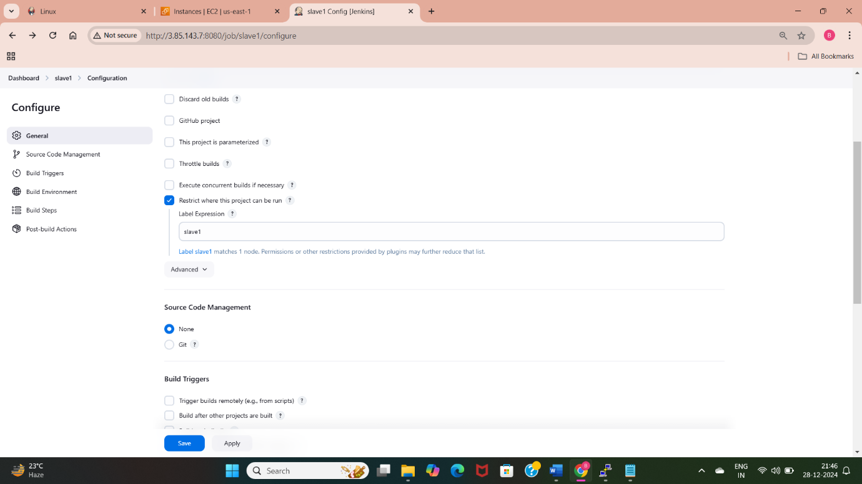
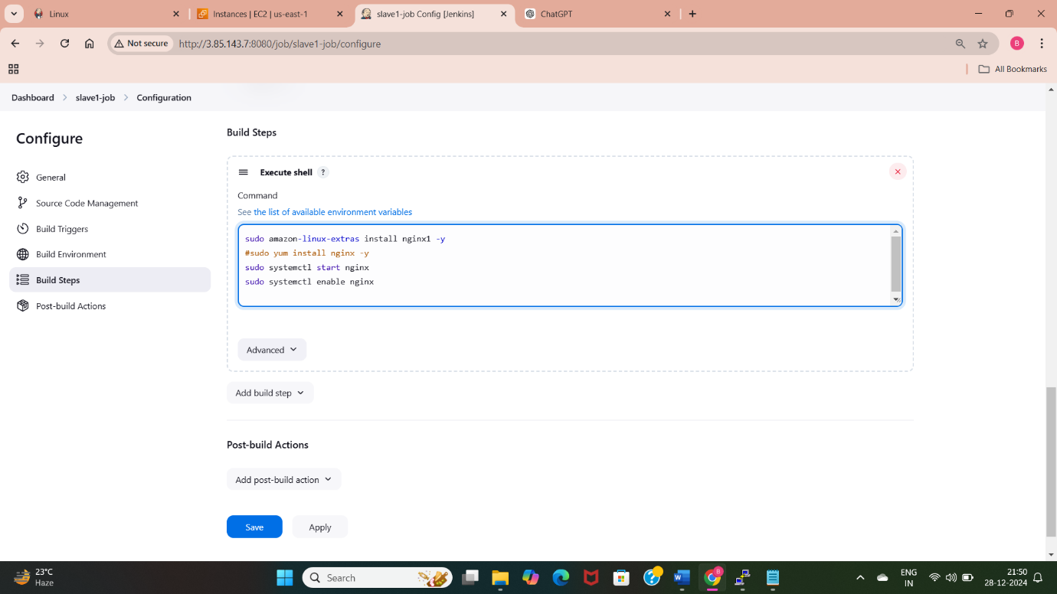
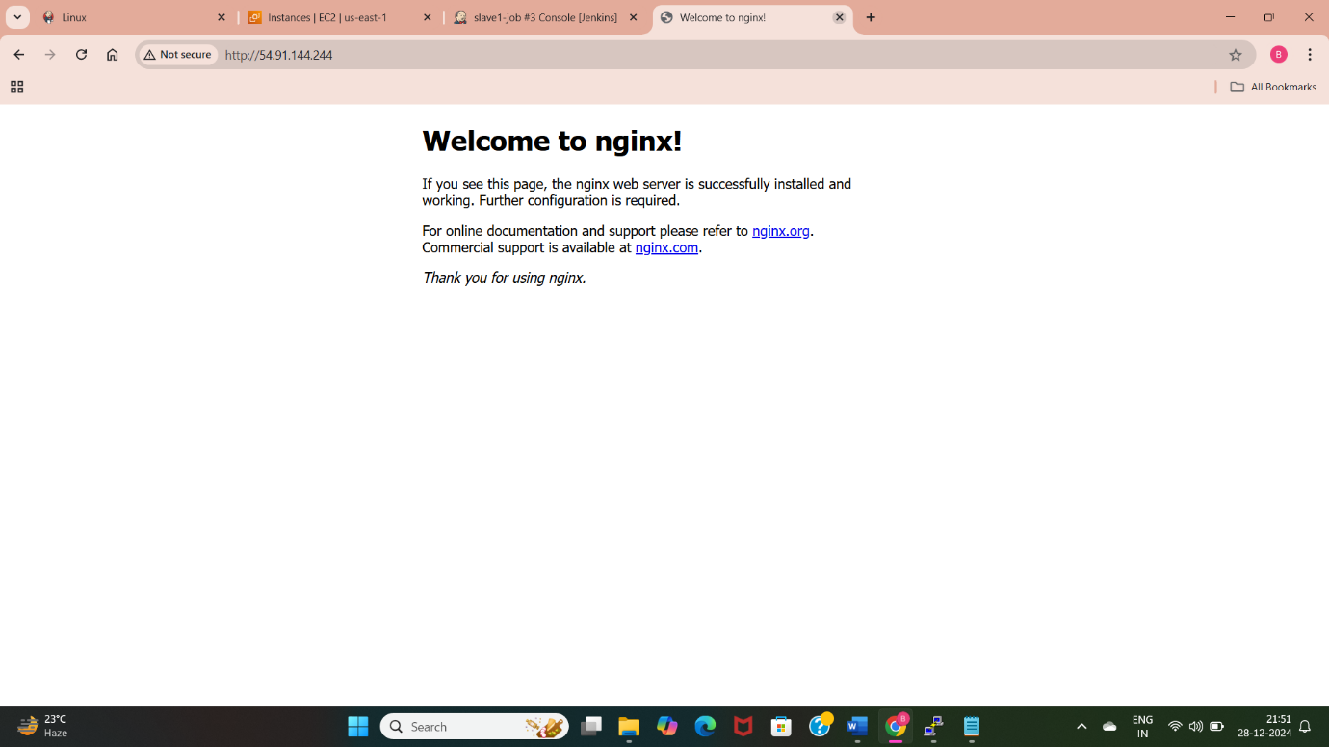

Slide 8
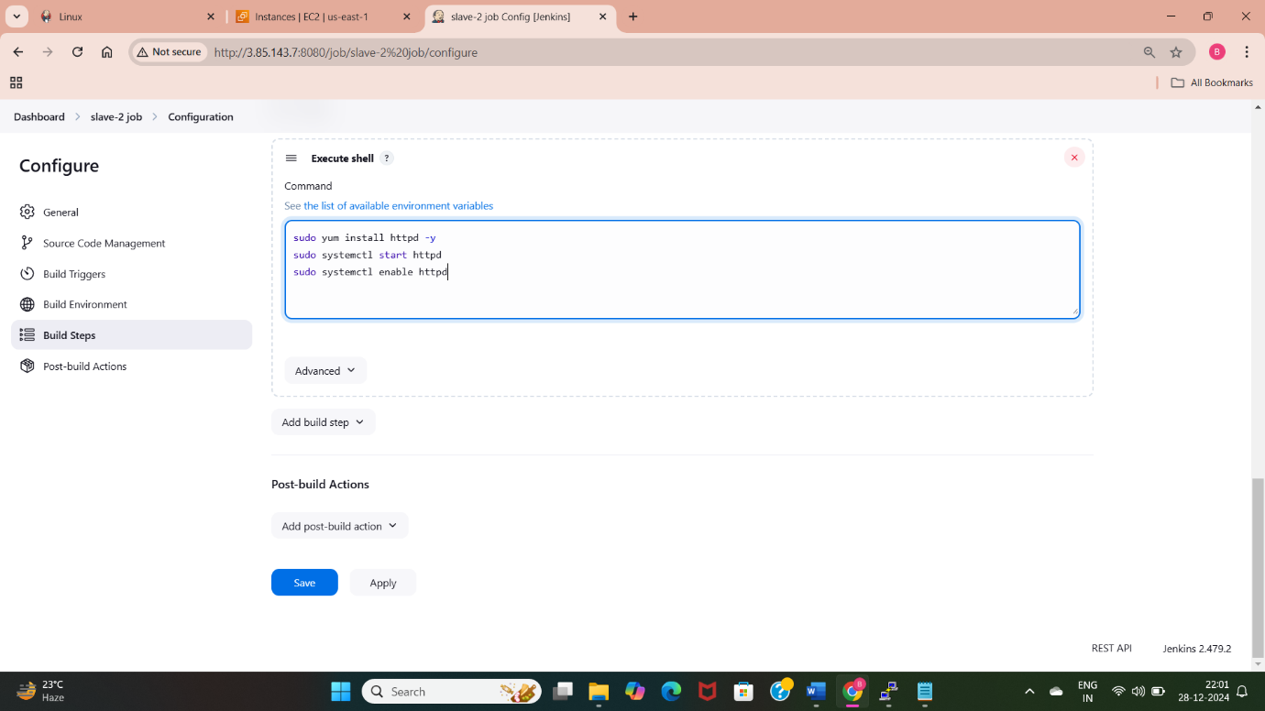
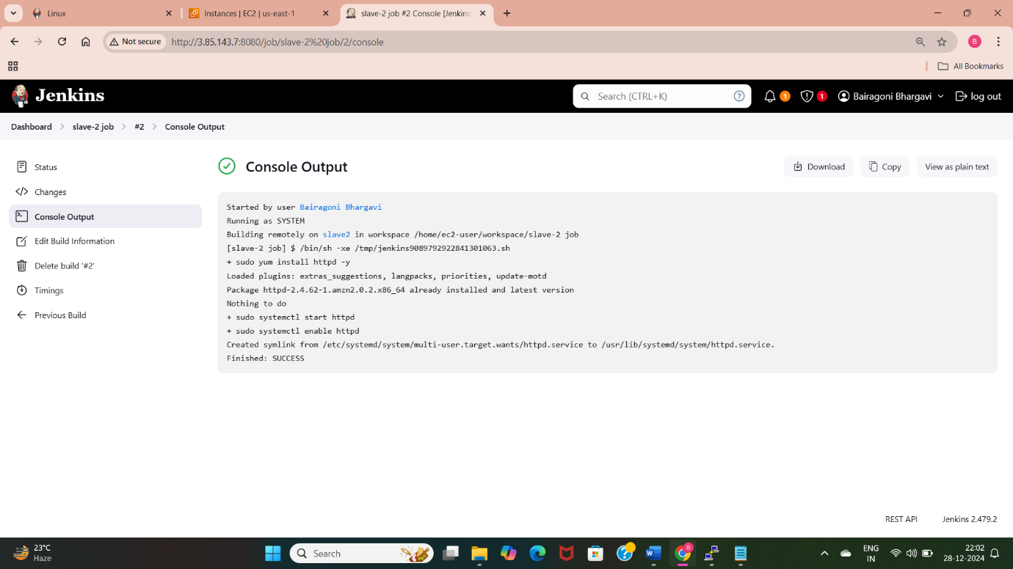
Slave-2
Install and configure Httpd.
Install dependency of Jenkins in slave2 server.
Connect slave2 server with master using public key of master.
Create slave2 node and job in Jenkins.
Write installation commands in execute shell of created job.
Check with the console output whether the build is success or not.
Console output provides detailed steps of
execute shell building process.

Slide 9
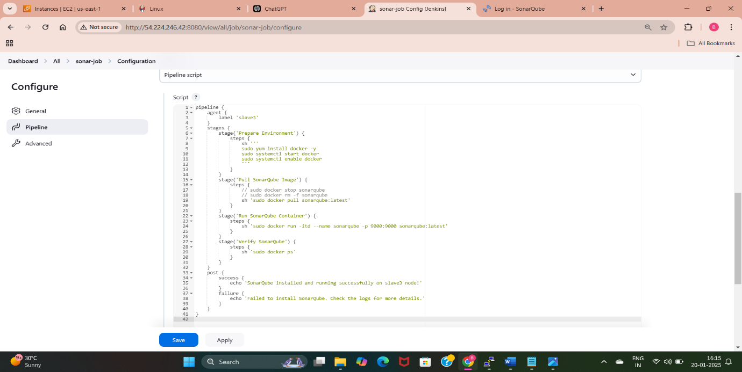
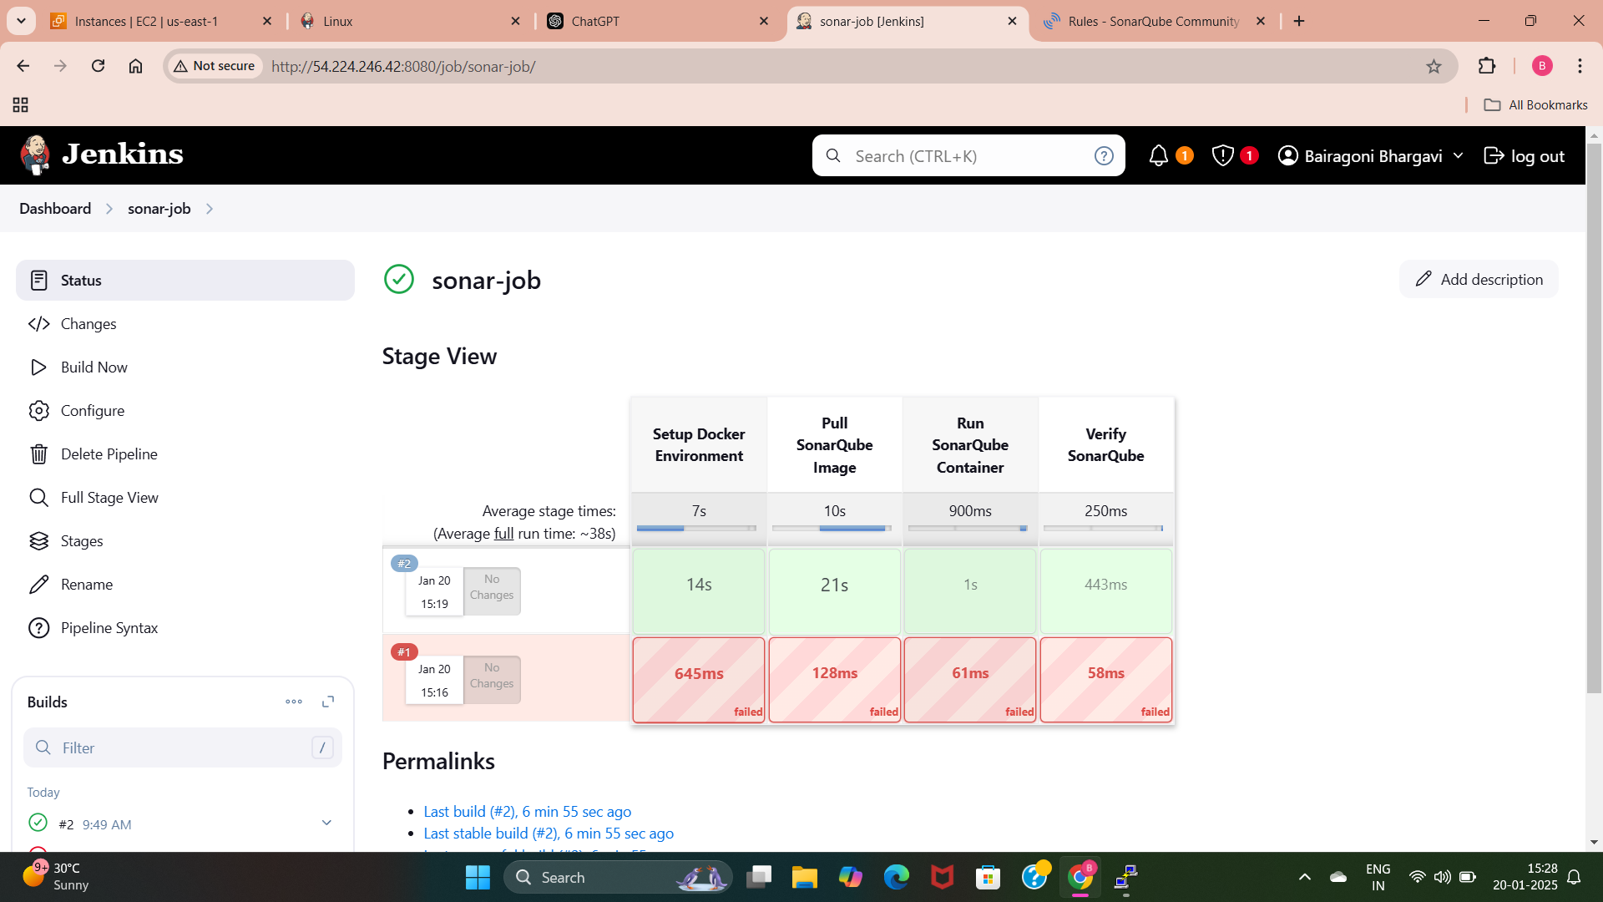
Slave-3
Setup SonarQube for code quality analysis.
Create a node for slave3 server.
Select the created label to run the builds.
Create a pipeline to install sonarqube and start sonarqube using execute shell.
Use the public Ip address of this instance with sonar port 9000 and see the sonar page.

Slide 10
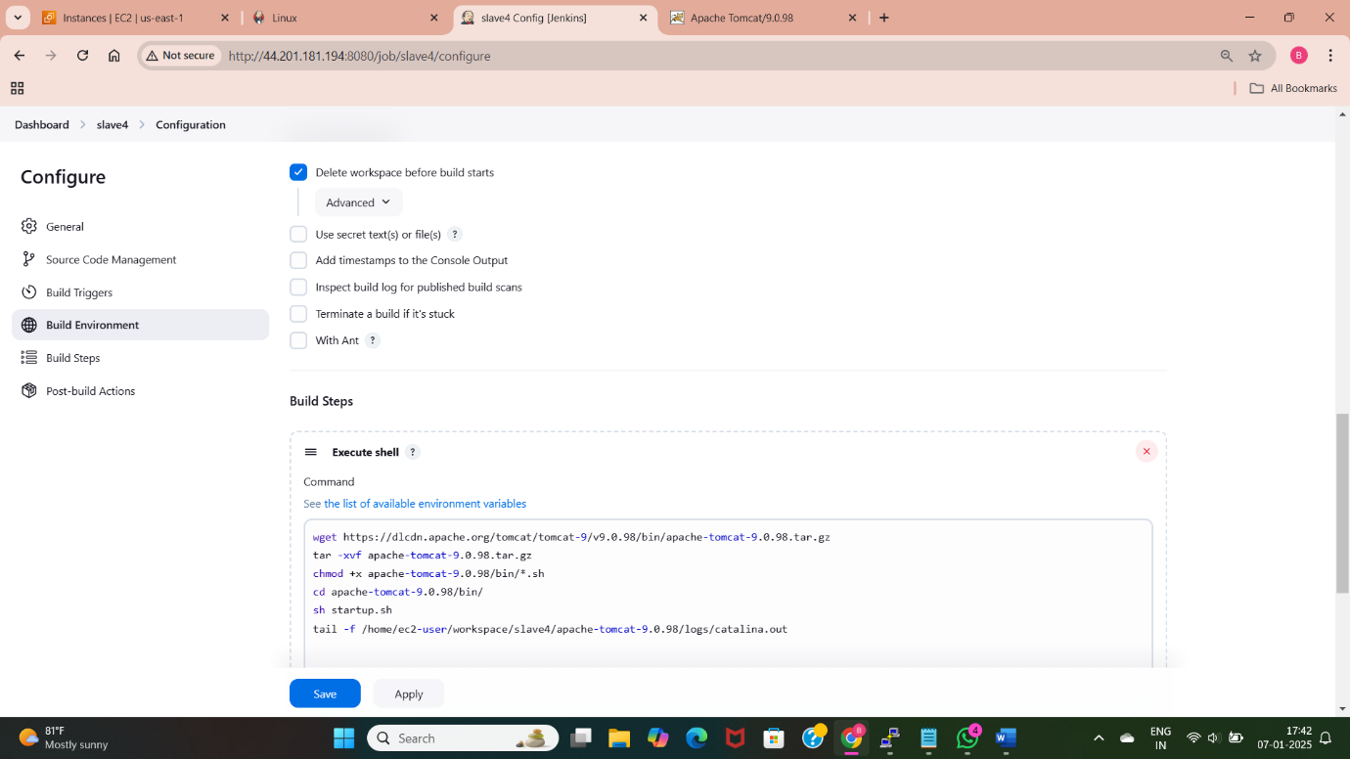
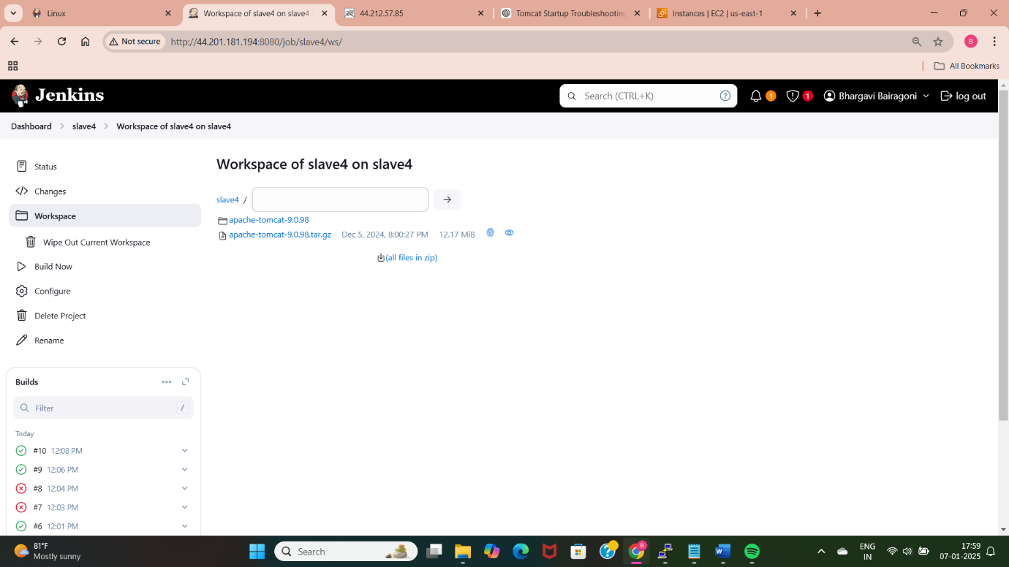
Slave-4
Install Tomcat server.
Create slave4 node.
Select the label to build the project.
In execute shell provide the download commands to install tomcat and give required permissions.
Start the tomcat and access it using the public IP and tomcat port(8080).

Slide 11
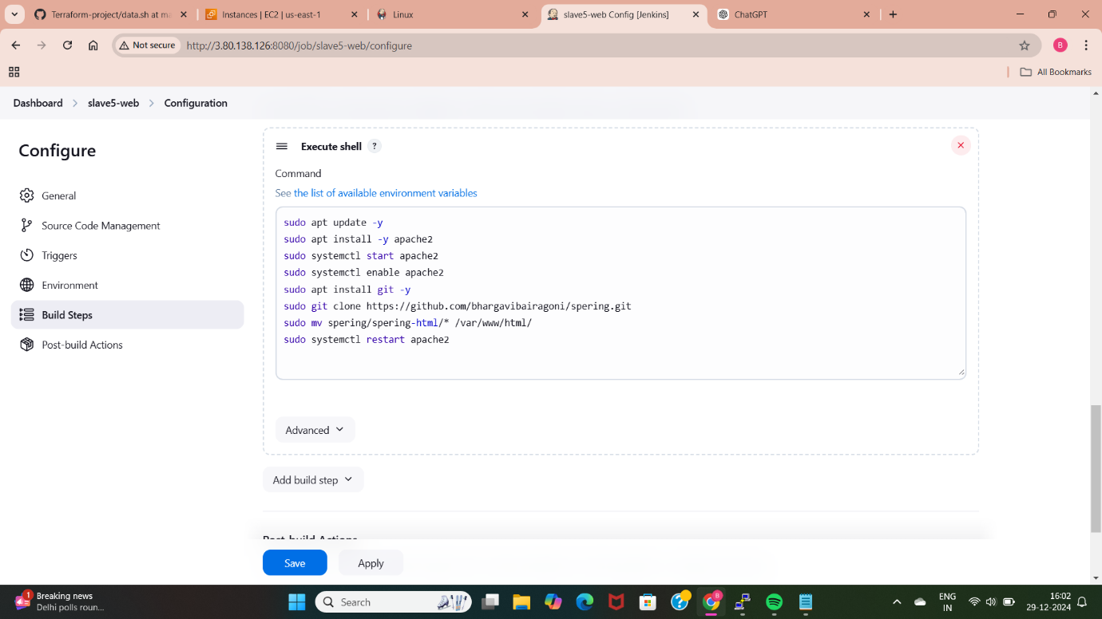
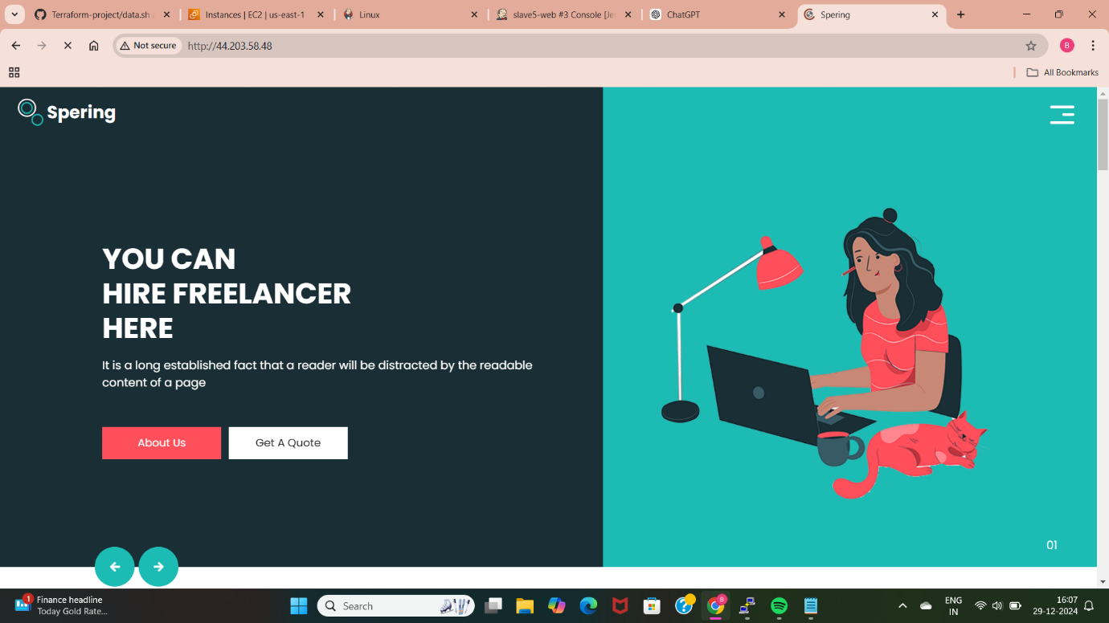
Slave-5
Deploy a static web application on either Nginx or Httpd.
Create a slave5 node in Jenkins.
Install git in slave5 server.
Take the github url which is having the static web application code.
Select the created label.
In execute shell write the commands to move code files to nginx of httpd root directory and restart the page.
Access the deployed web application using public IP address of slave5 server.

Slide 12
METHOD-2
Master and Slave Nodes Configuration:
Master: Controls all deployment processes.
Slave Nodes:
Slave-1: Manual deployment of a Python web application.
Slave-2: Python web app deployment using a Bash script.
Slave-3: Use Terraform to provision infrastructure and deploy the Python app.
Slave-4: Manual deployment of a Java-based application.
Slave-5: Java app deployment using a Bash script executed via shell.

Slide 13
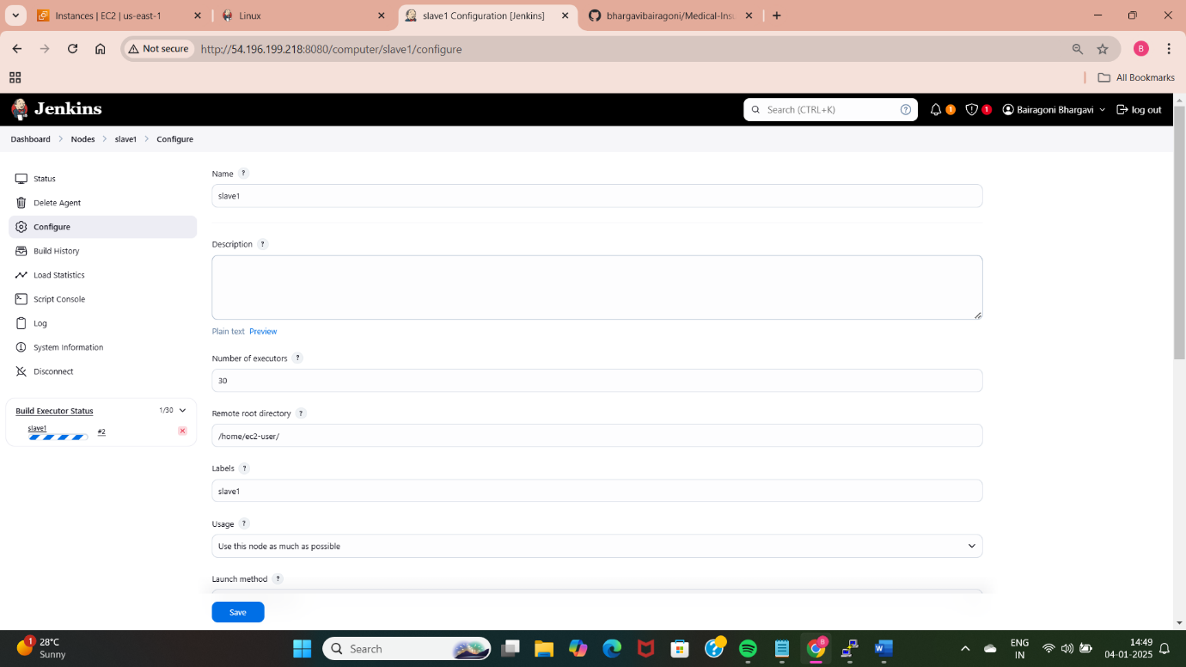
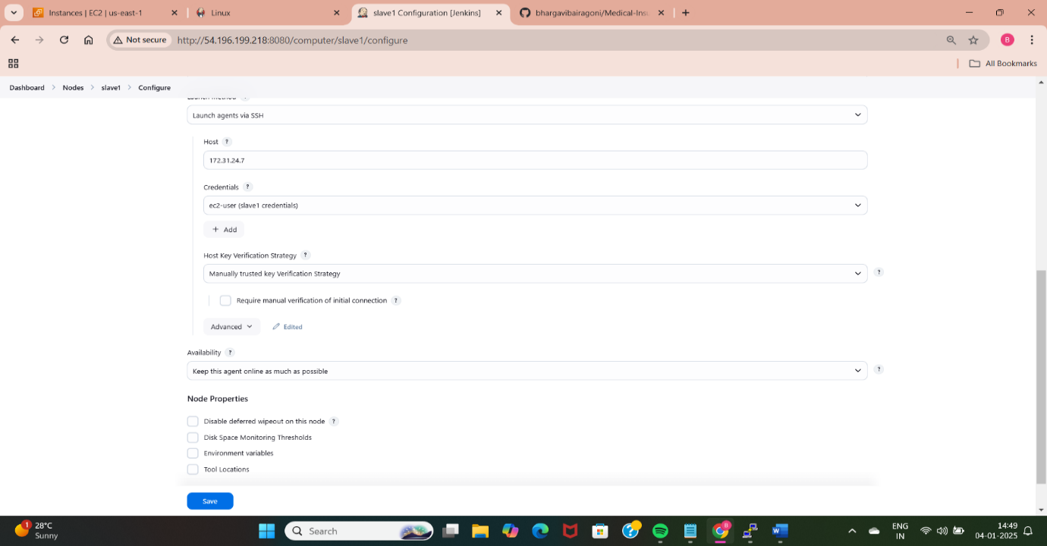
Slave-1
1. Python Web Application Deployment:
Manually set up Python app environment and deploy the app.
In execute shell write commands to install python, and pip3.
Clone the python application repository.
Install the requirements of python application “pip3 install –r requirements.txt”.
Run the command to deploy the app “python3 app.py”

Slide 14
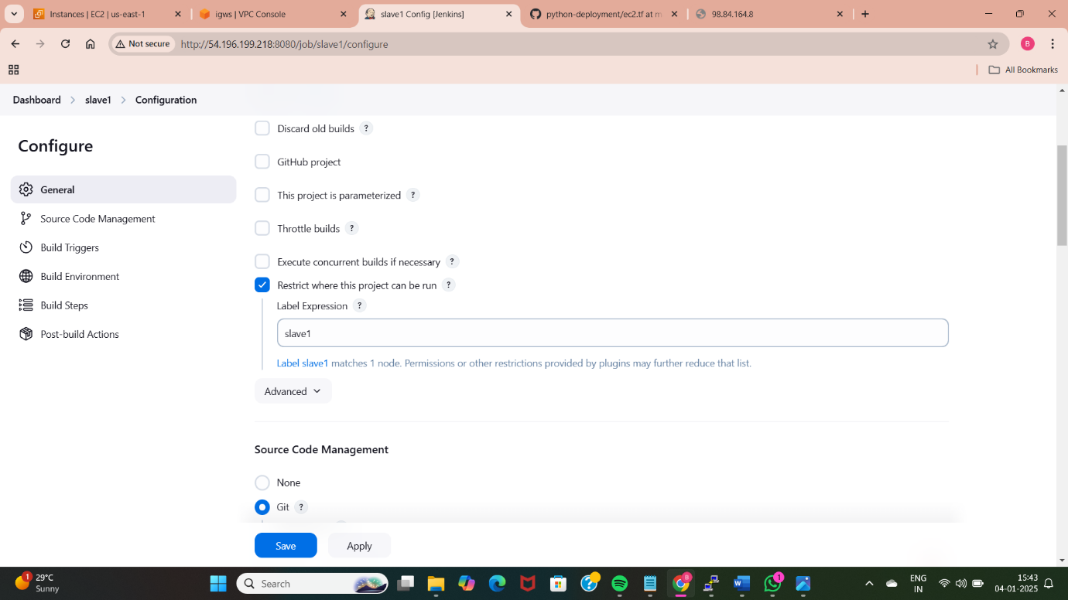
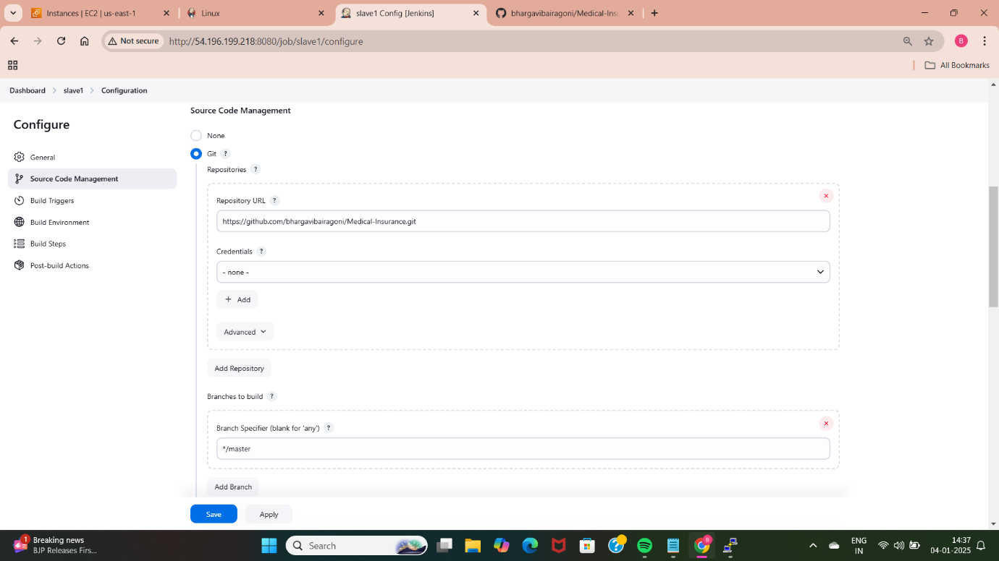
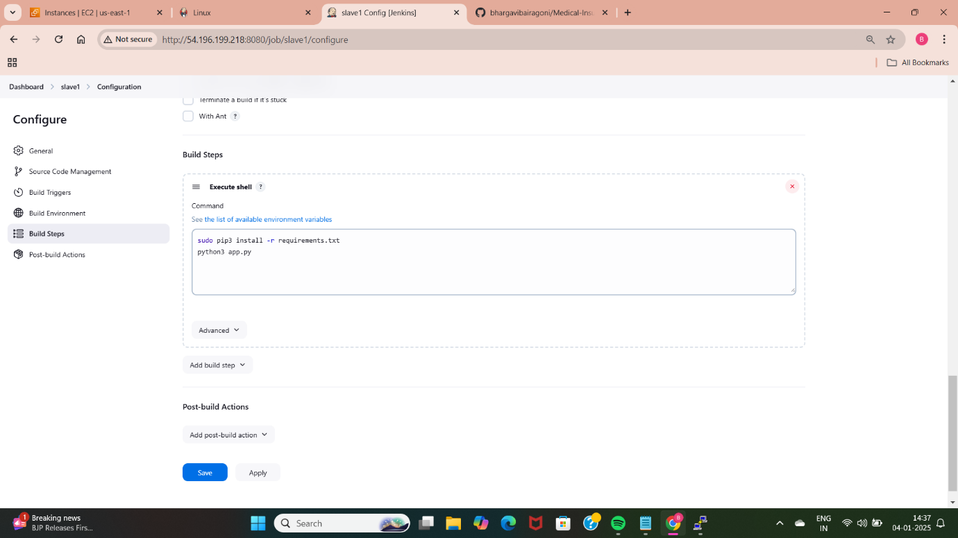
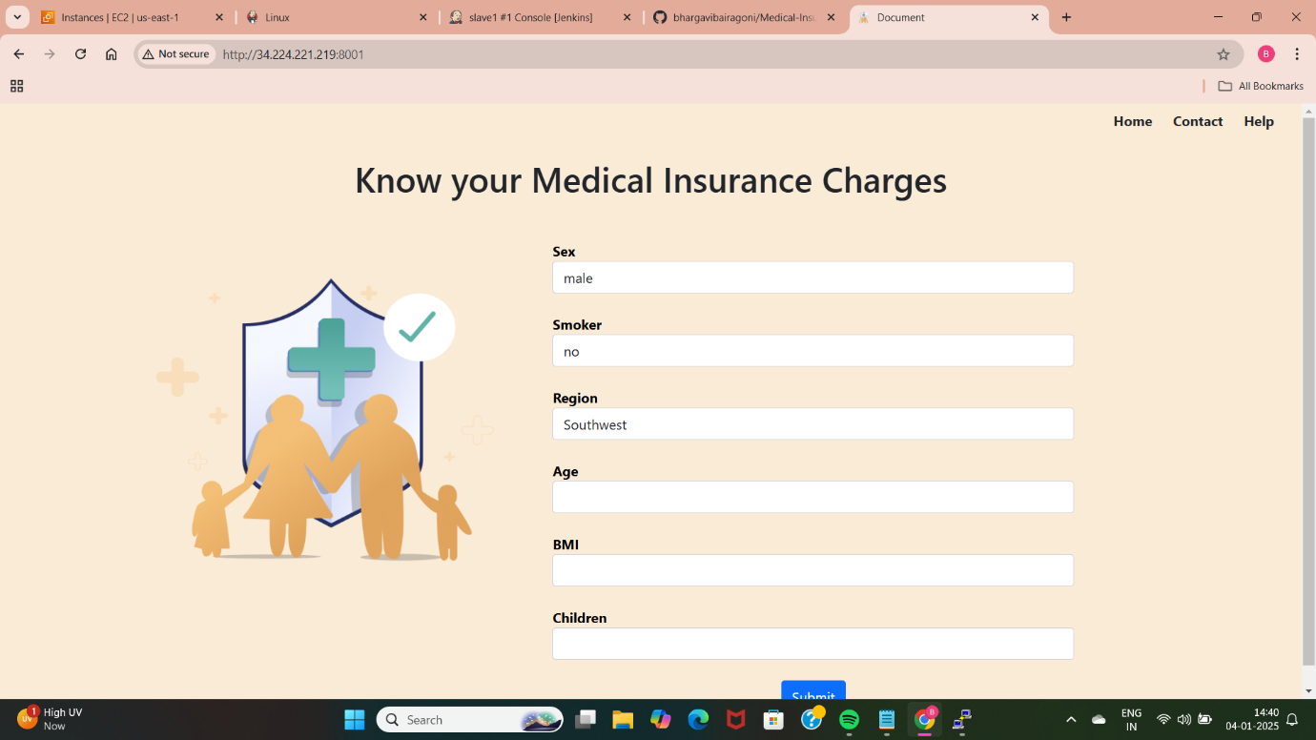

Slide 15
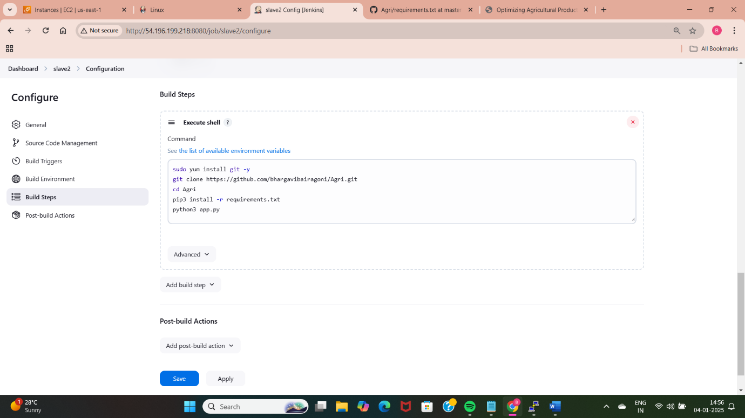
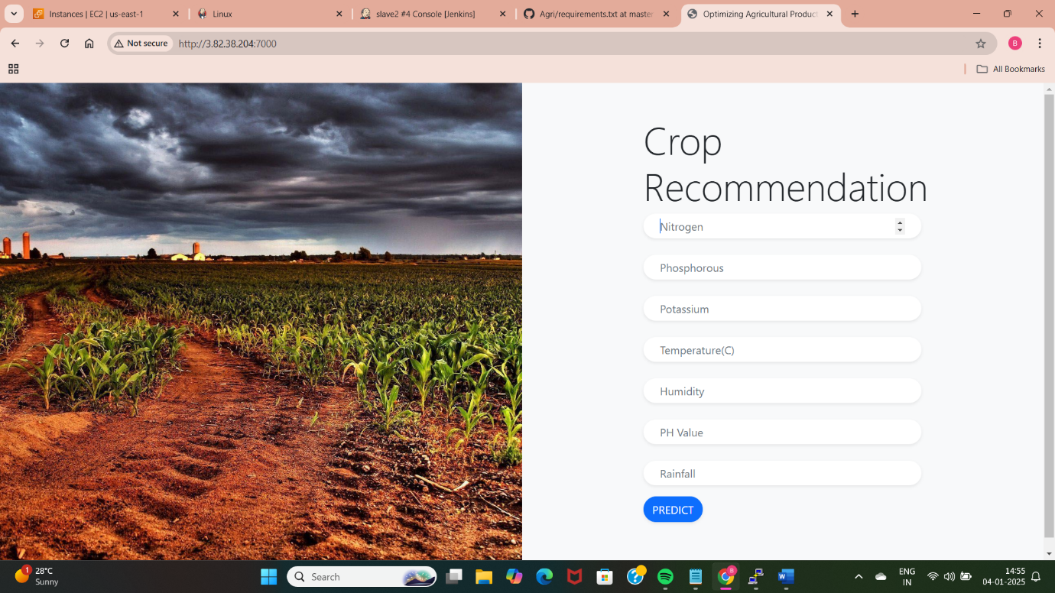
Slave-2
Deploy python application using Bash Script.
Create slave2 node and select the created label.
Write a Bash script in execute shell to automate the Python app deployment.
Access the application using the slave2 public IP address.

Slide 16
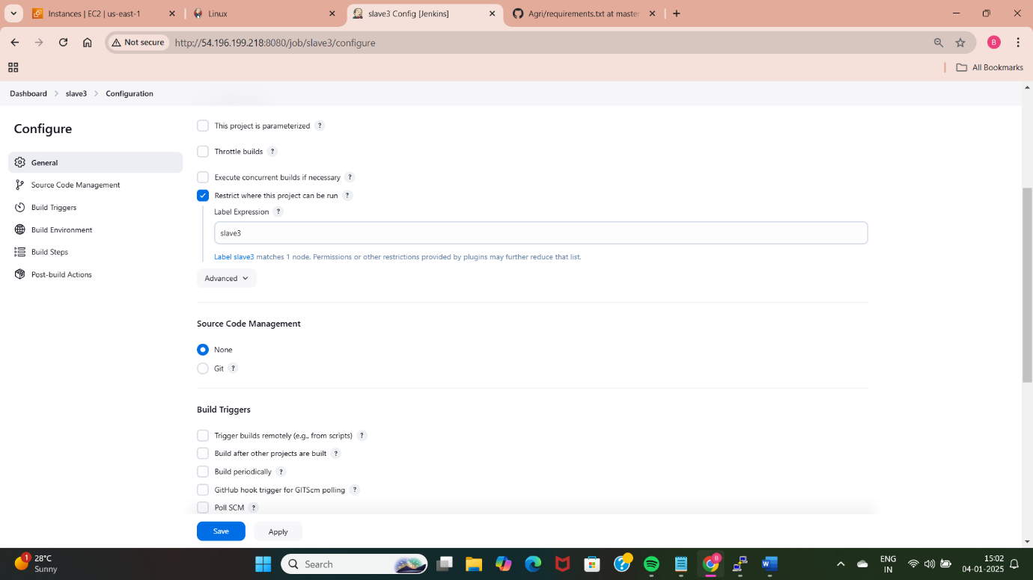
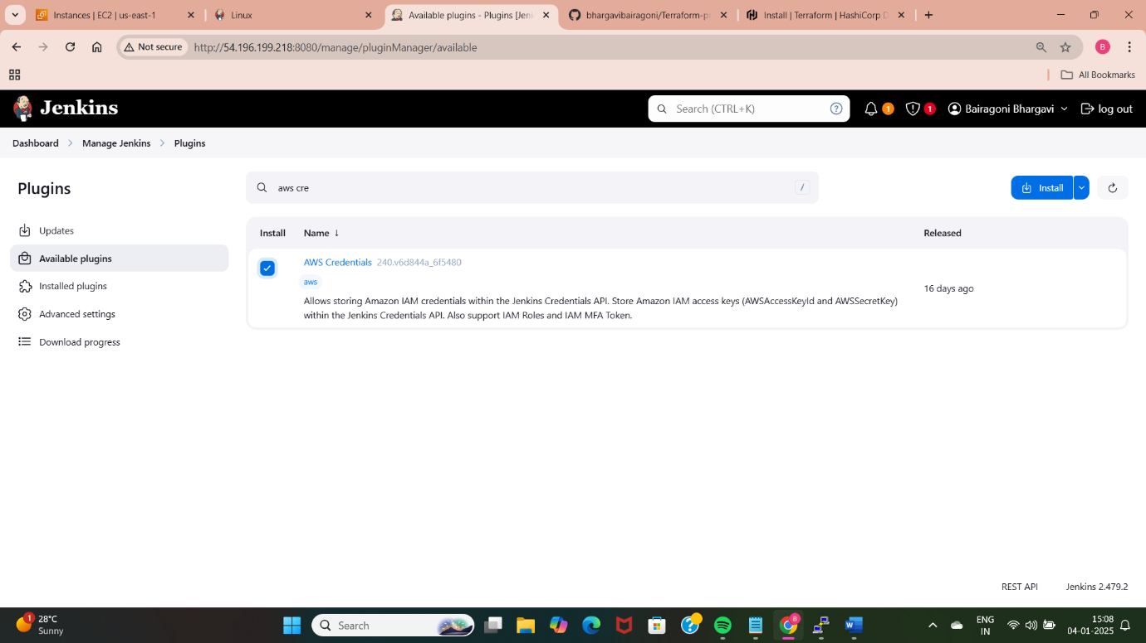
Slave-3
Deploy python application using Terraform with Jenkins.
Use Terraform to provision infrastructure and deploy the Python app.
Install aws credentials plugin.
Install terraform and initialize in the created files.
Check the plan using “terraform plan”
Create the resources and deploy app using “terraform apply –auto-approve”.

Slide 17
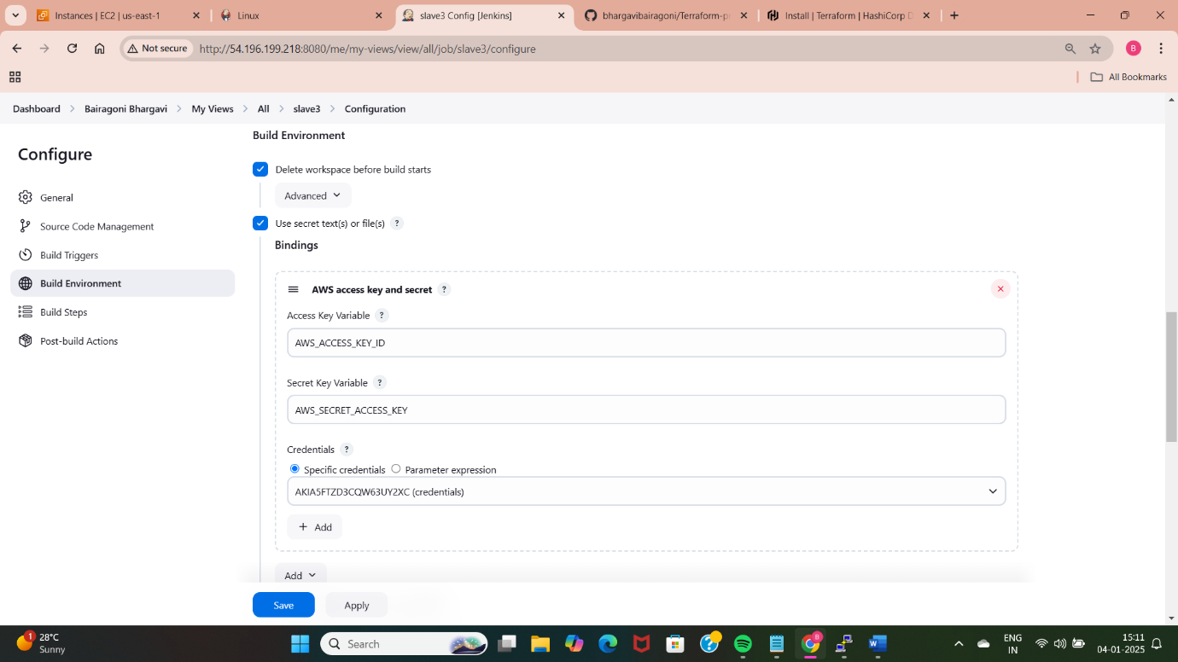
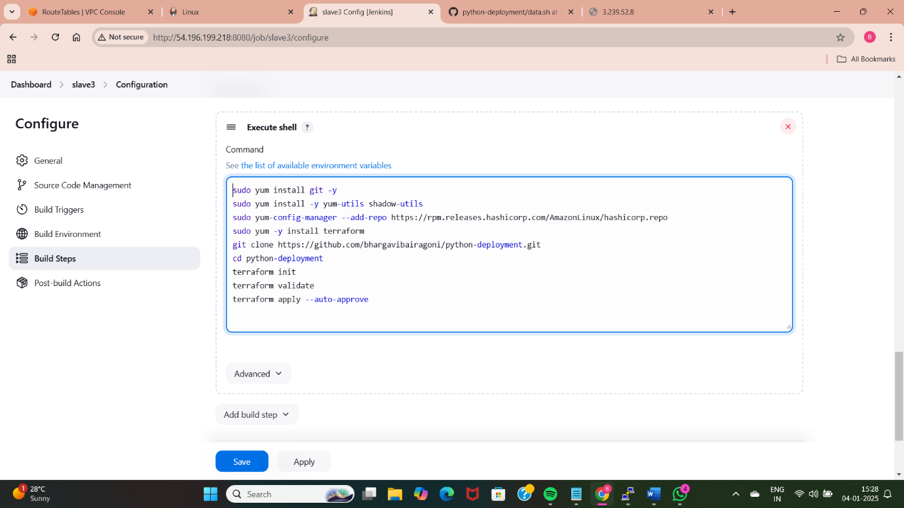
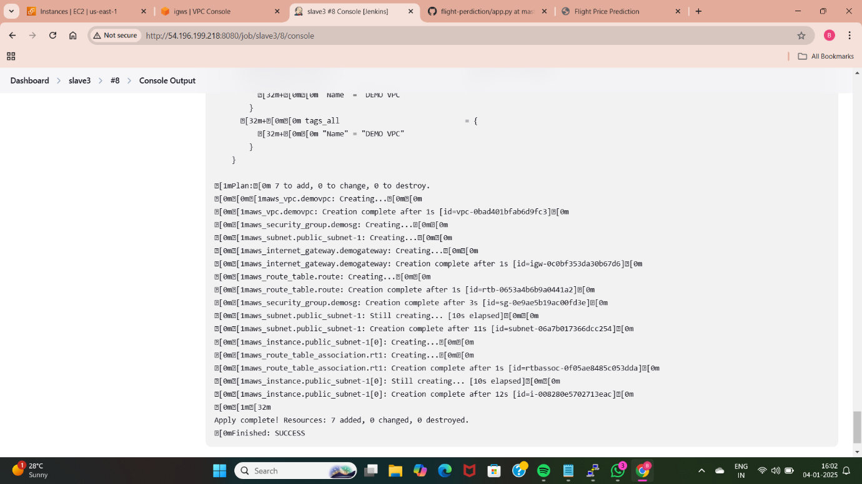
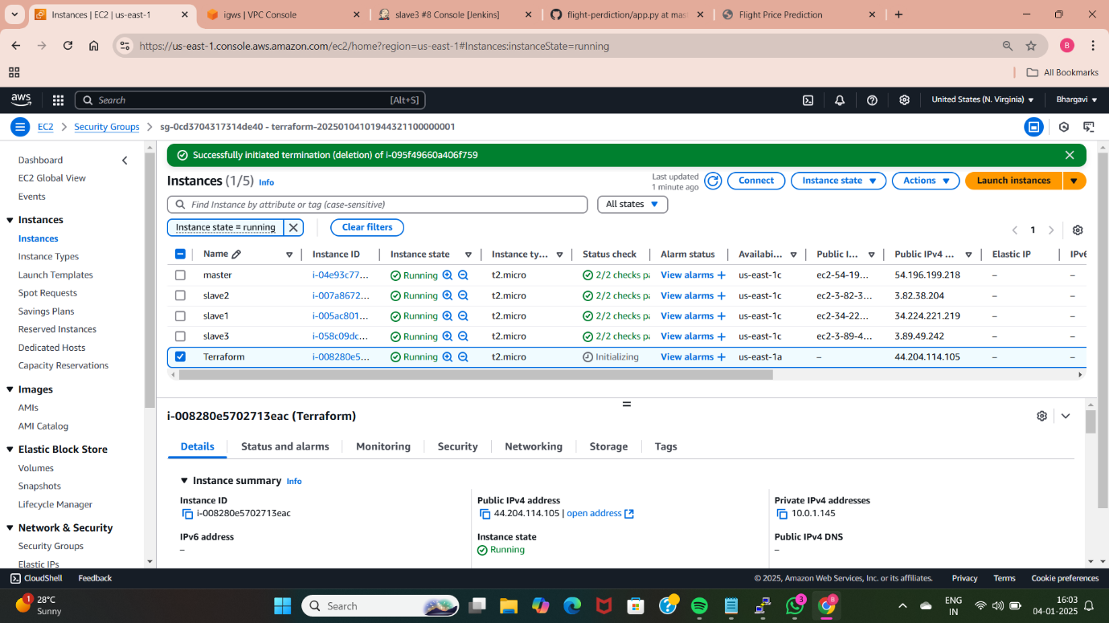

Slide 18
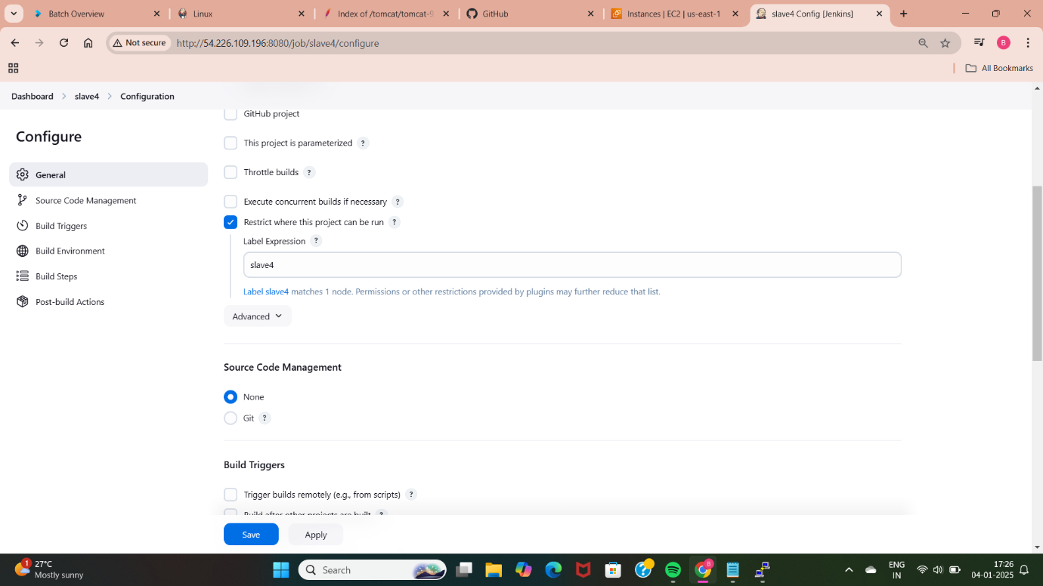
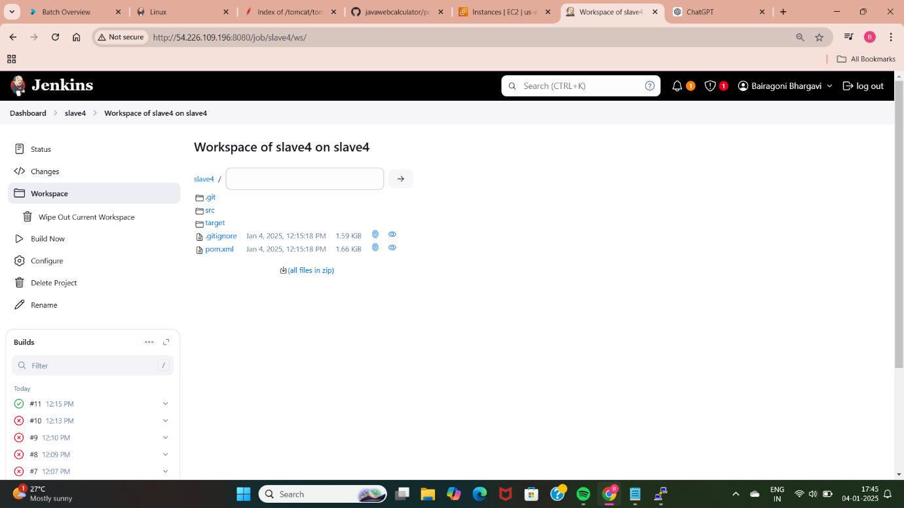
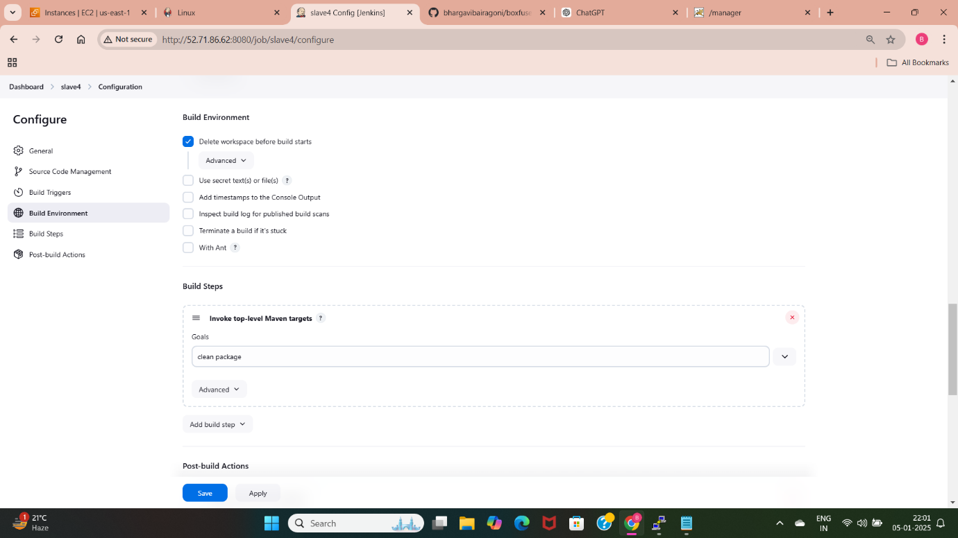
Slave-4
Java-Based Application Deployment:
Manually install and deploy a Java-based app (e.g., WAR file on Tomcat).
Install maven and generate target file.
Install and setup tomcat in slave4 server.
Install deploy war ear to container plugin to deploy application into tomcat.

Slide 19
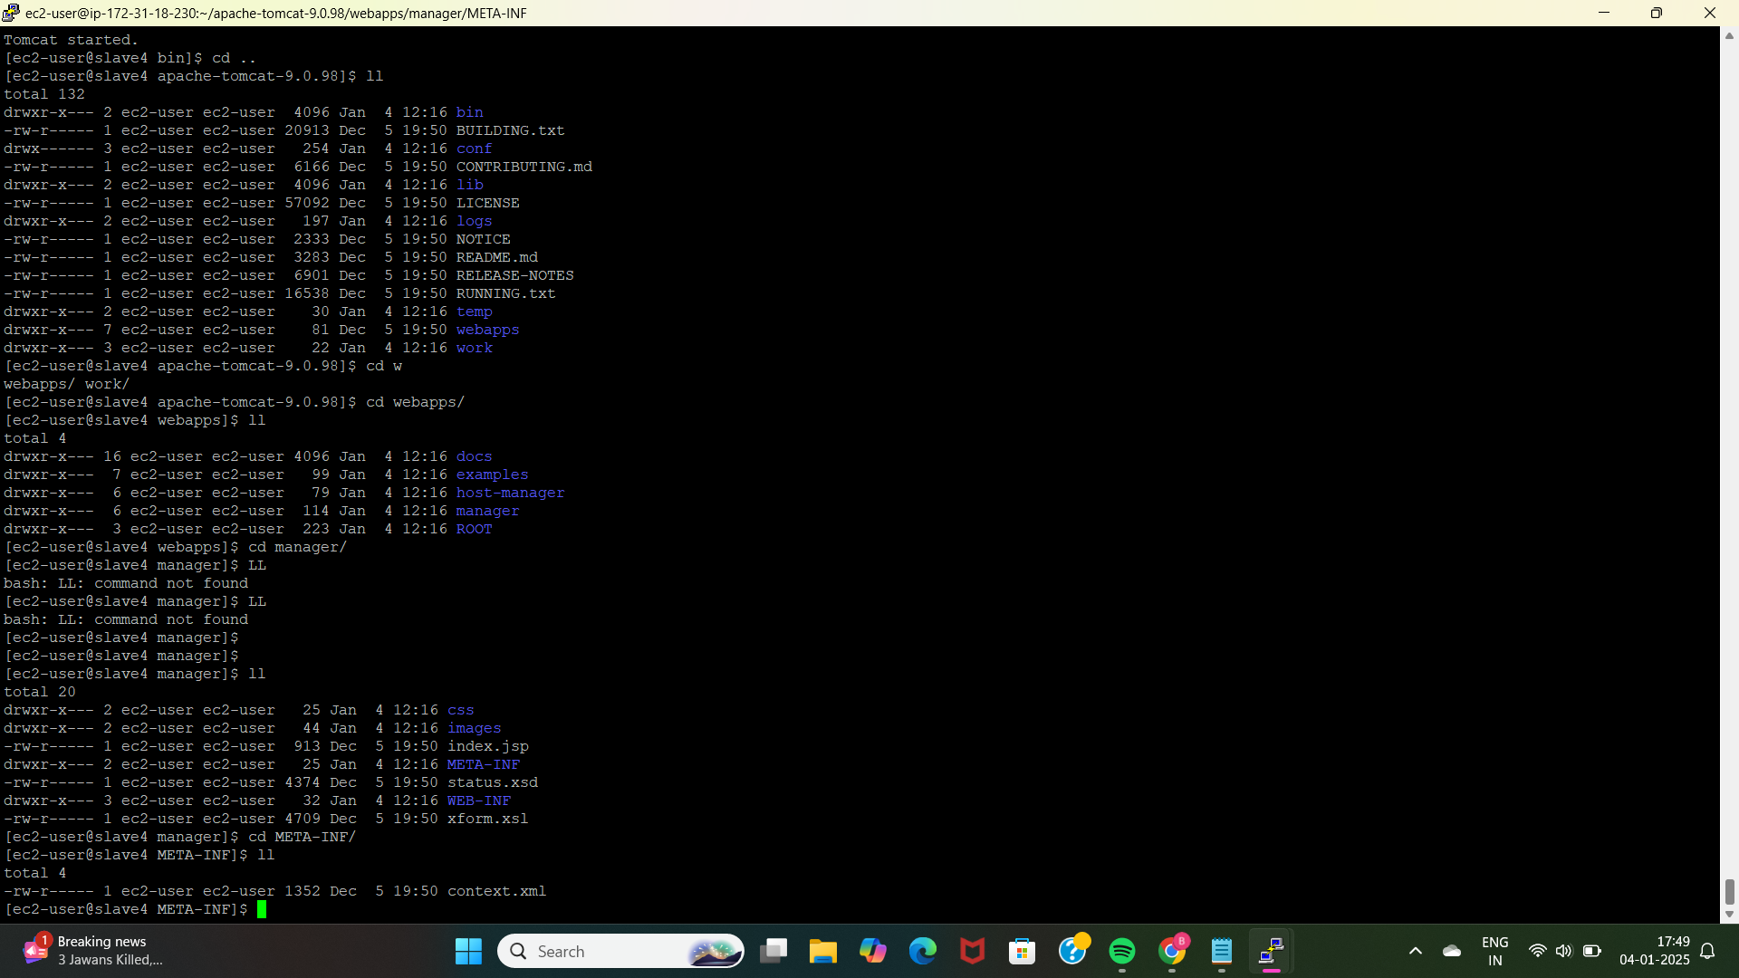
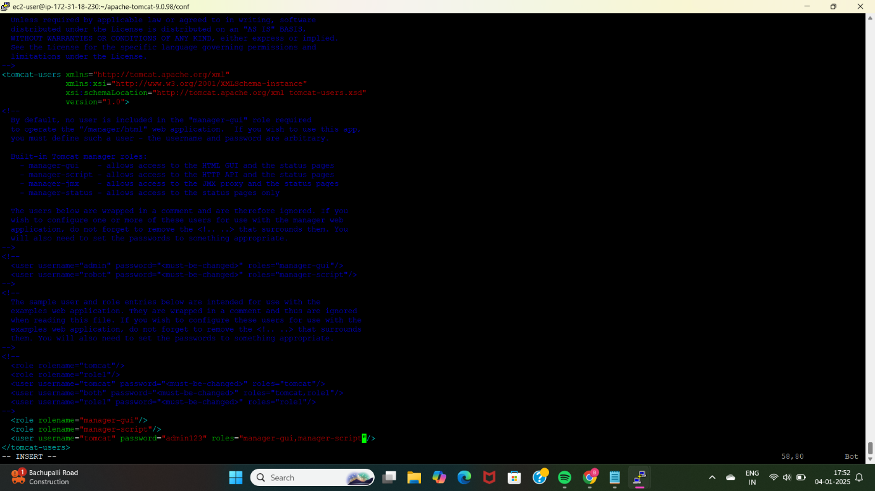
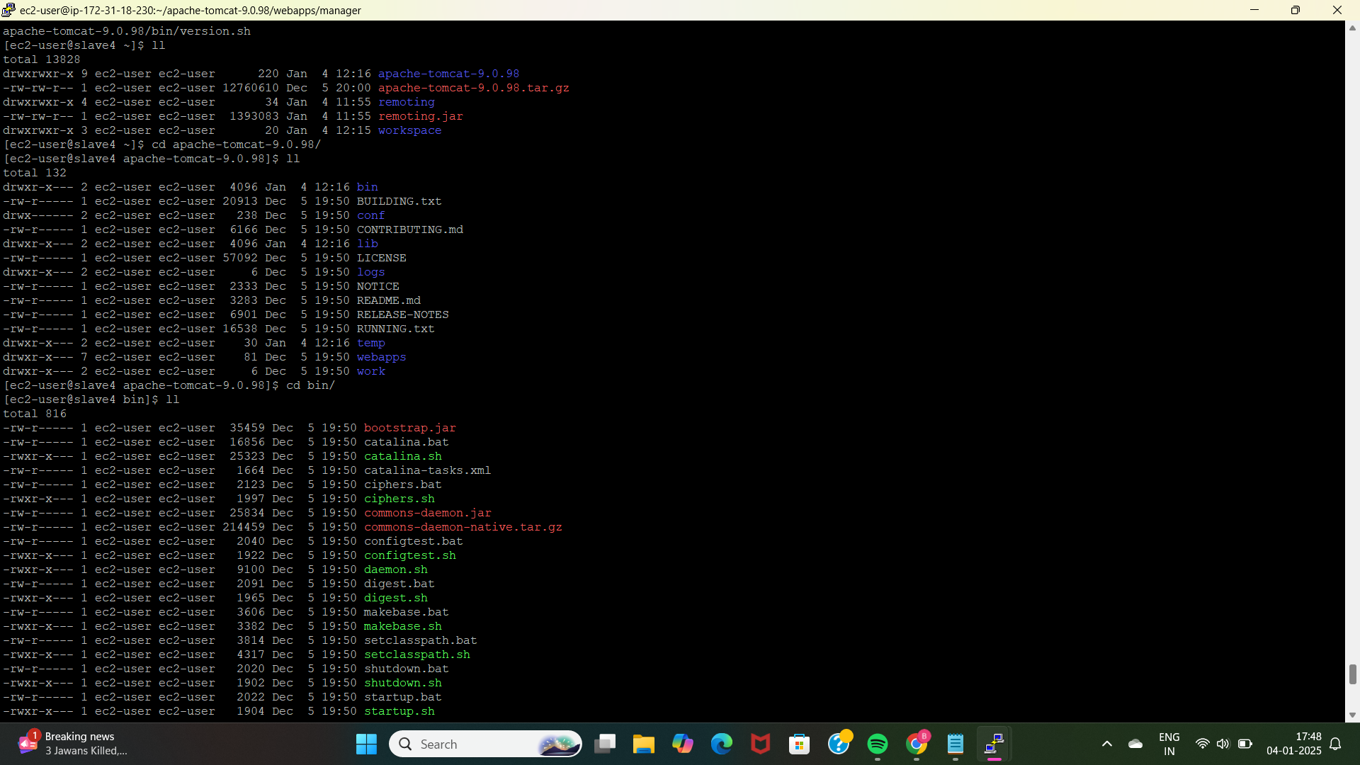
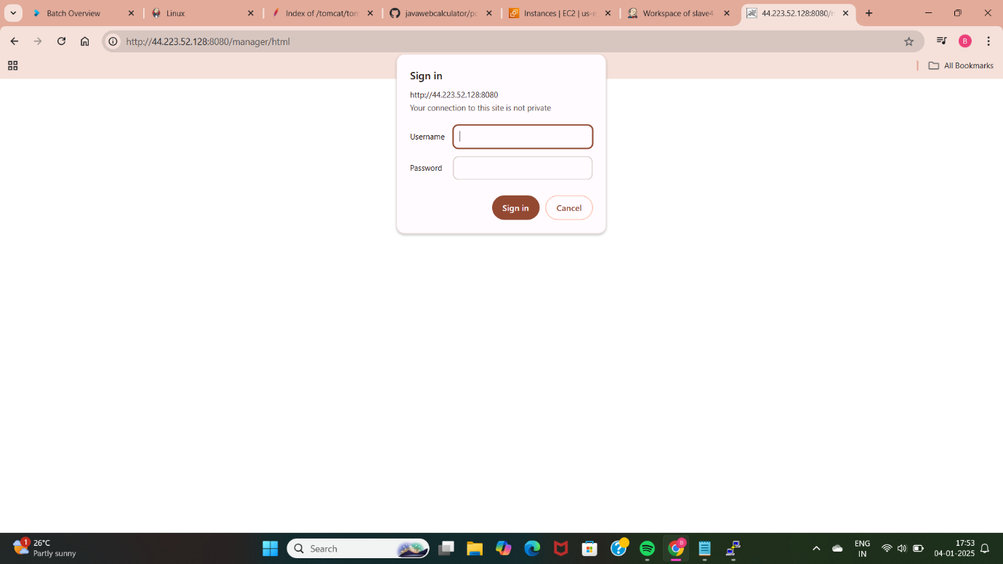

Slide 20
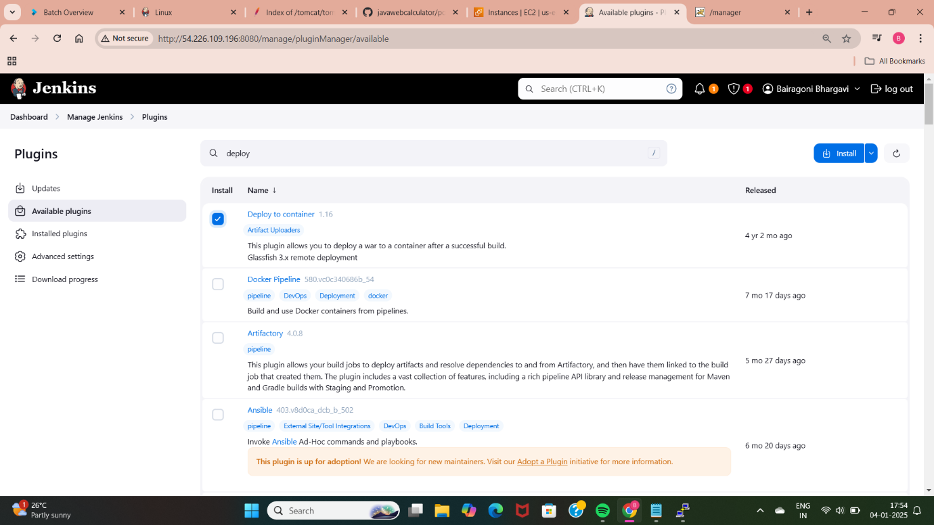
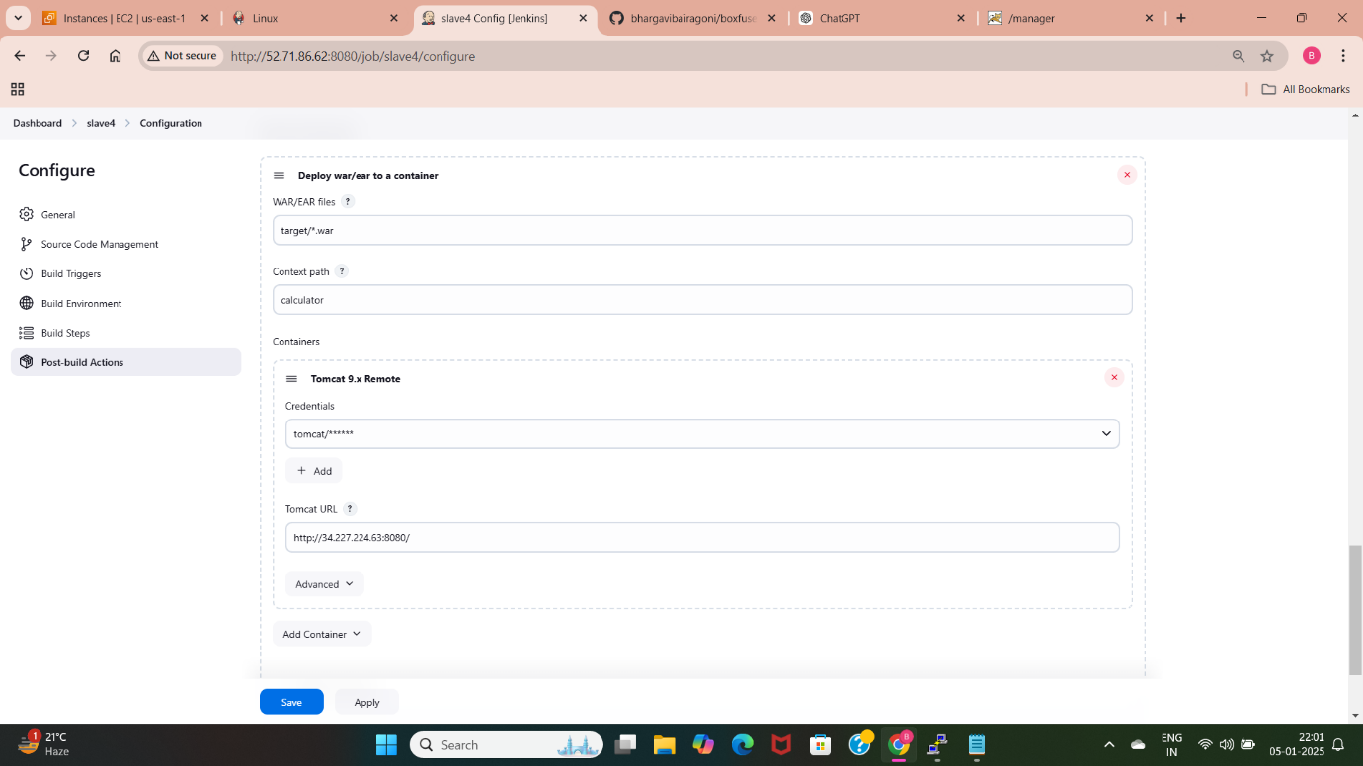
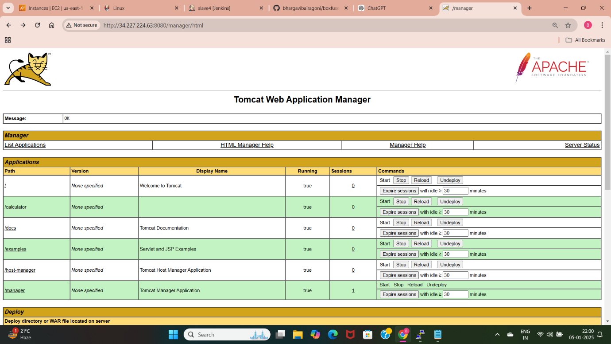
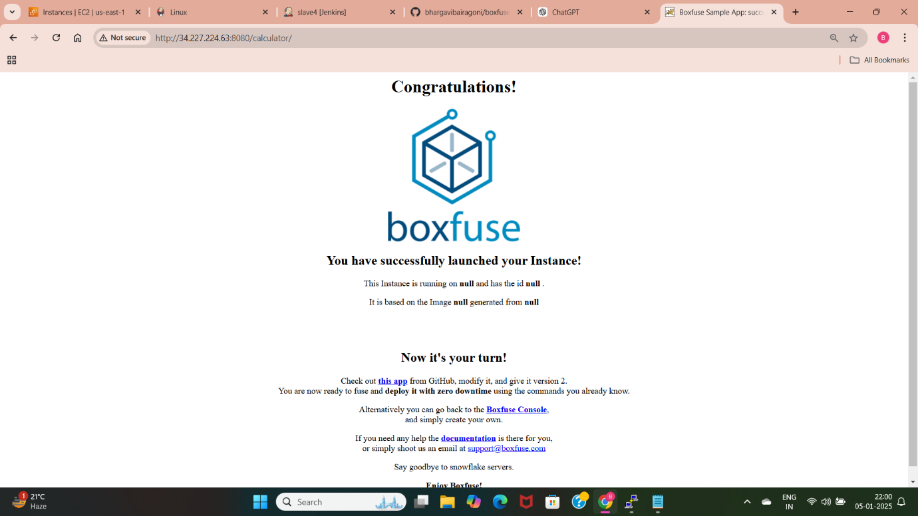

Slide 21
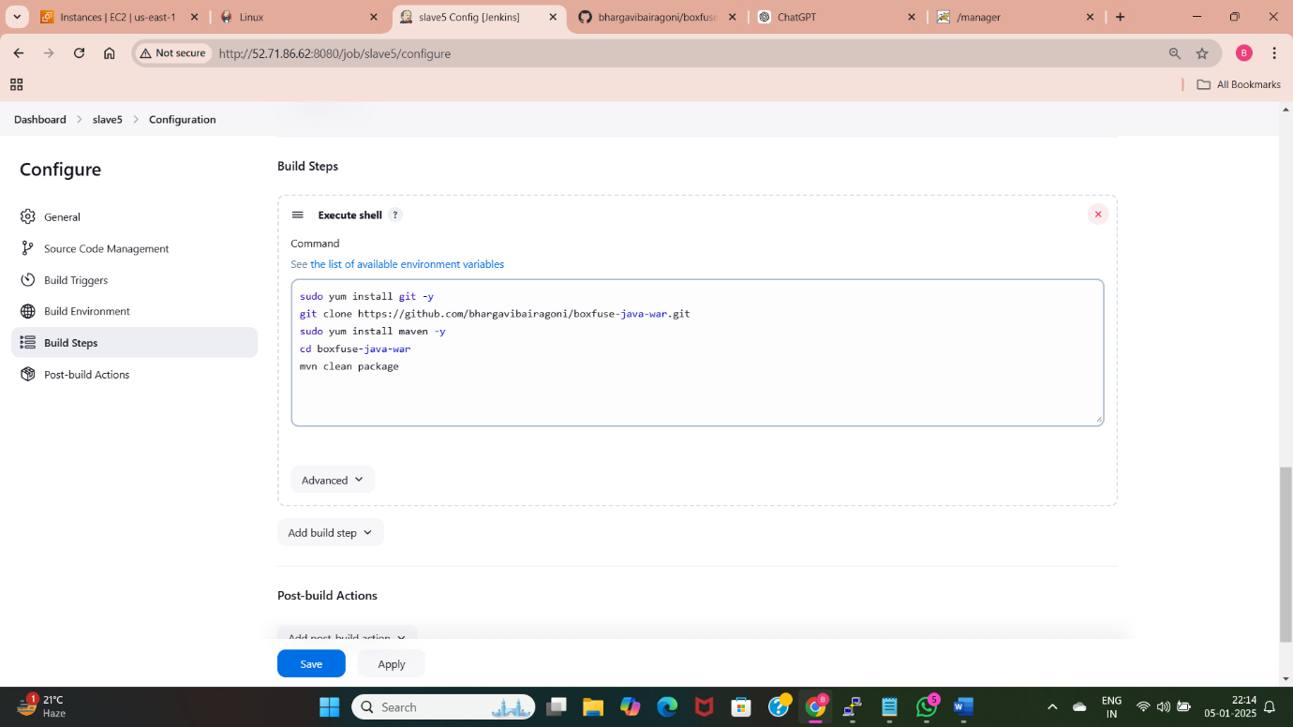
Slave-5
Deploy java application using Bash script.
Use a Bash script to automate deployment via execute shell in Jenkins.
In execute shell write commands to install maven and run “clean package”.
Install required plugin for tomcat.
Provide the tomcat url in the post build steps “deploy war/ear to container”.
Provide any name for the application.
Execute the build to deploy the application.

Slide 22

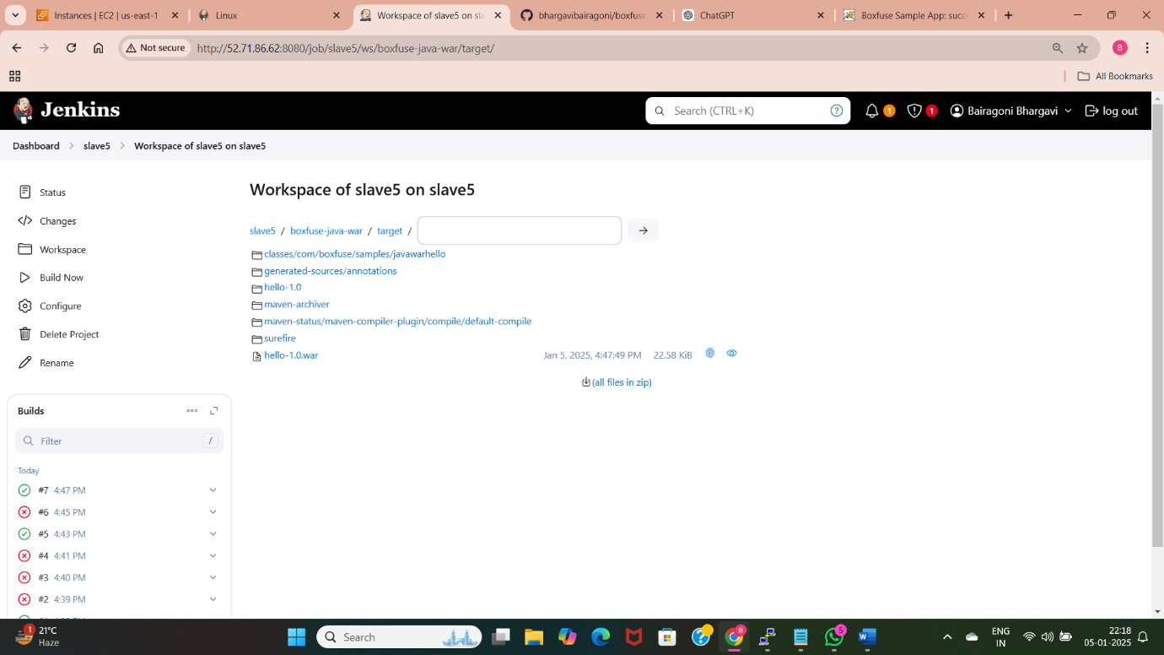
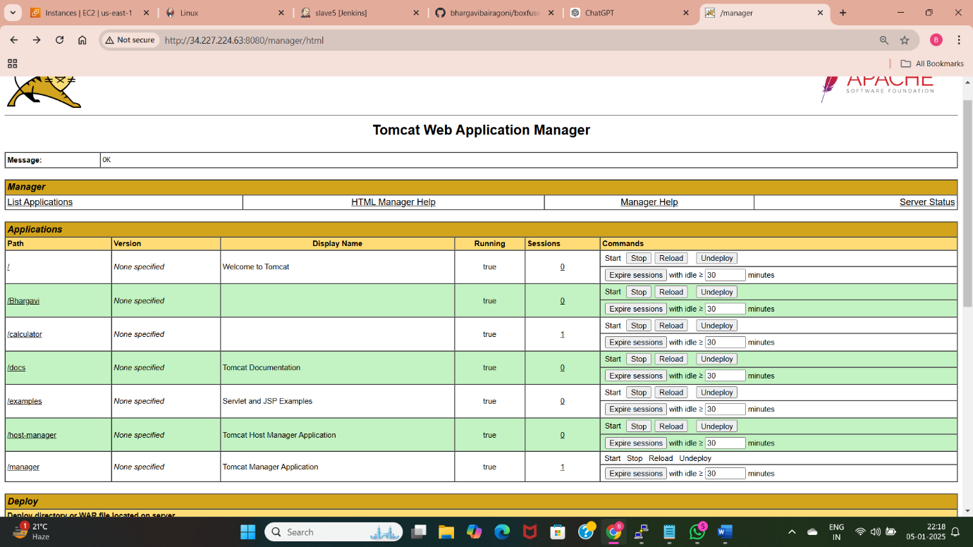
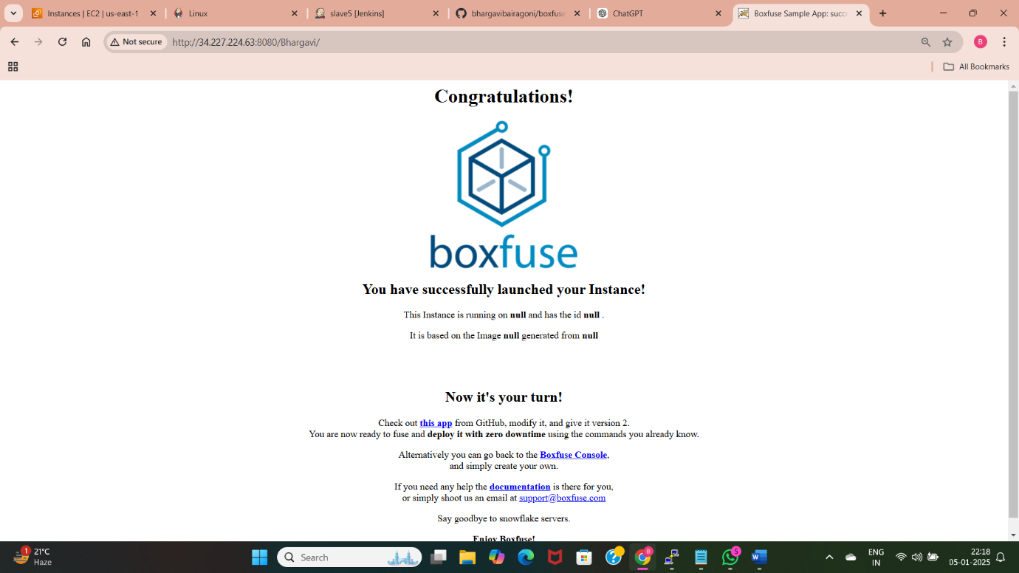

Slide 23
Thank You

